Slide 1
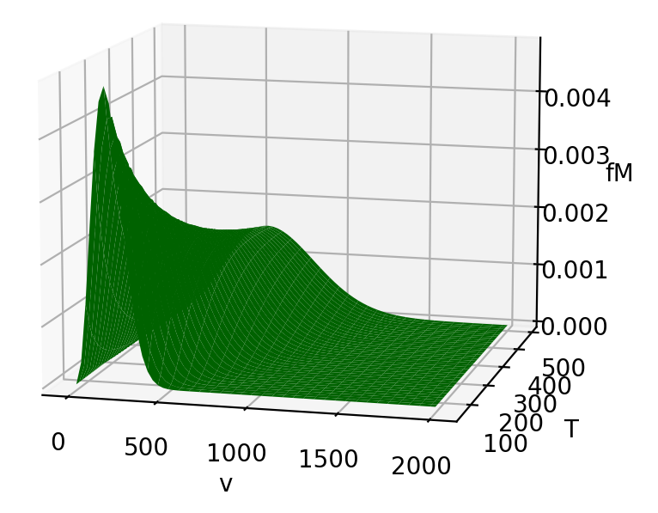
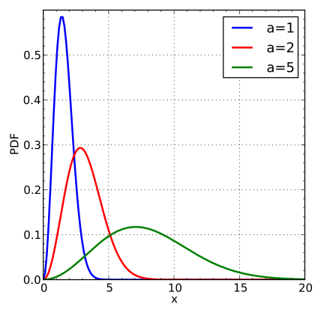
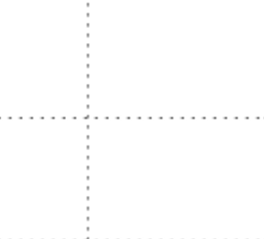
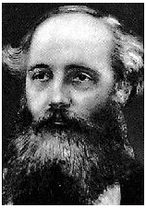
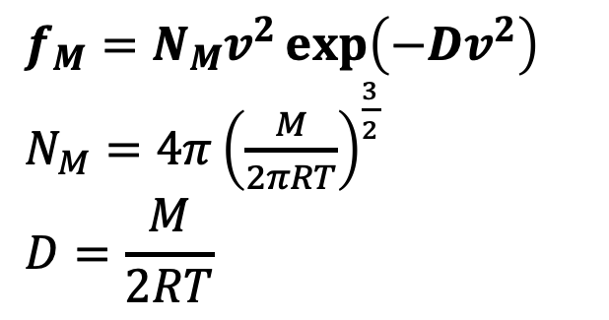
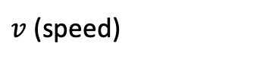
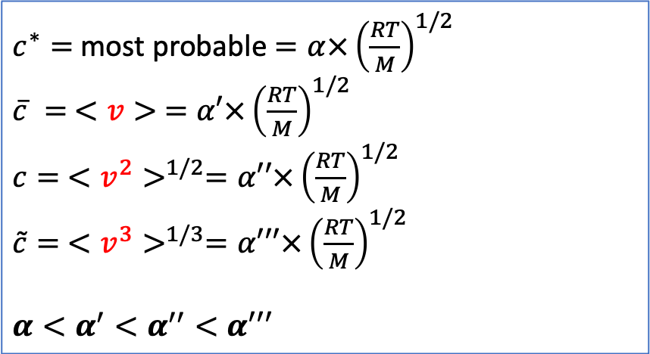
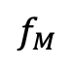
Recap: moments from the probability density functions
$$f_{M}=N_{M}v^{2}\exp\left(−Dv^{2}\right)$$
$N_{M}=4π{\left(\frac{M}{2πRT}\right)}^{\frac{3}{2}}$
$$D=\frac{M}{2RT}$$
$$f_{M}$$
$v$ (speed)
$c^{∗}=$ most probable $=α×{\left(\frac{RT}{M}\right)}^{1/2}$
$\overline{c} = <v> =α′×{\left(\frac{RT}{M}\right)}^{1/2}$
$c= <v^{2}>^{1/2}=α′′×{\left(\frac{RT}{M}\right)}^{1/2}$
$\tilde{c}= <v^{3}>^{1/3}=α′′′×{\left(\frac{RT}{M}\right)}^{1/2}$
$$α<α^{′}<α^{′′}<α′′′$$

Slide 2
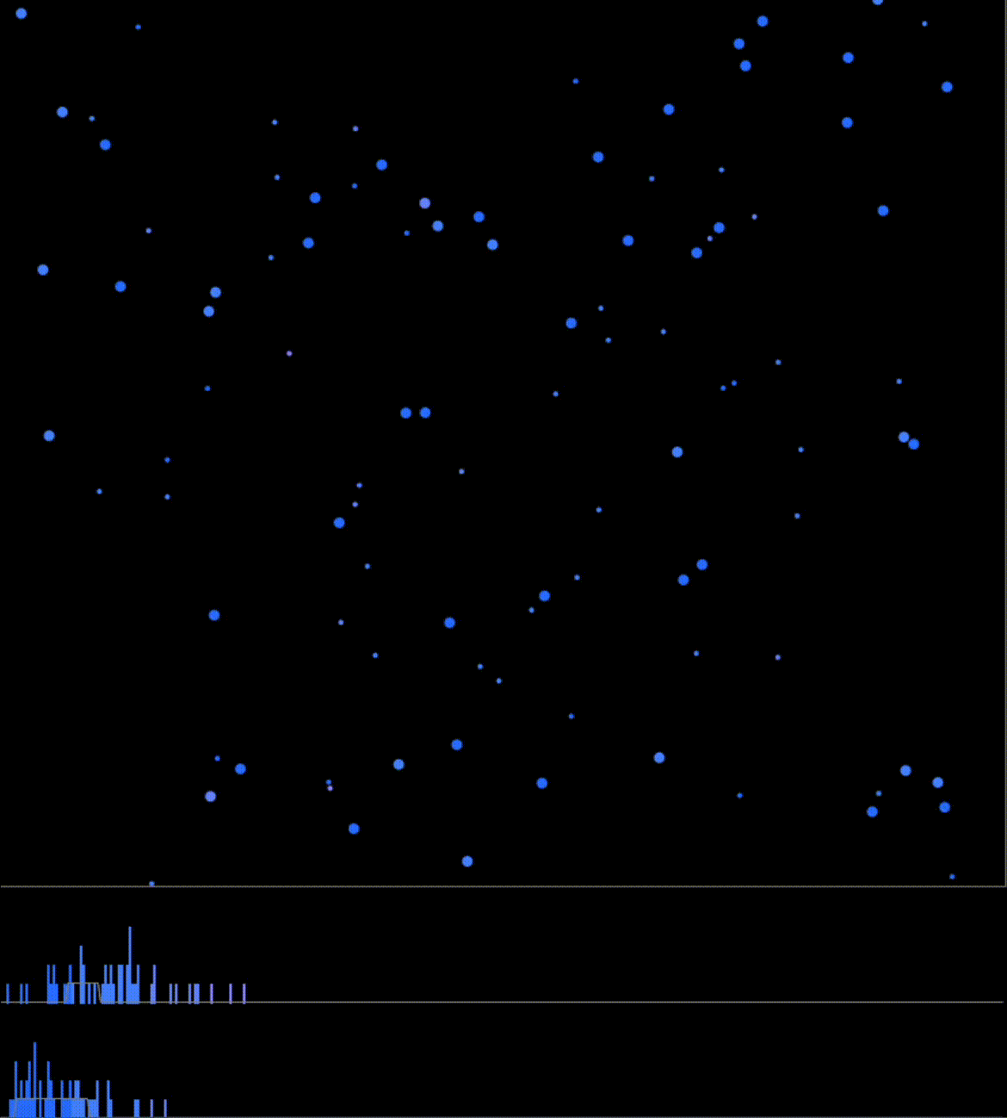
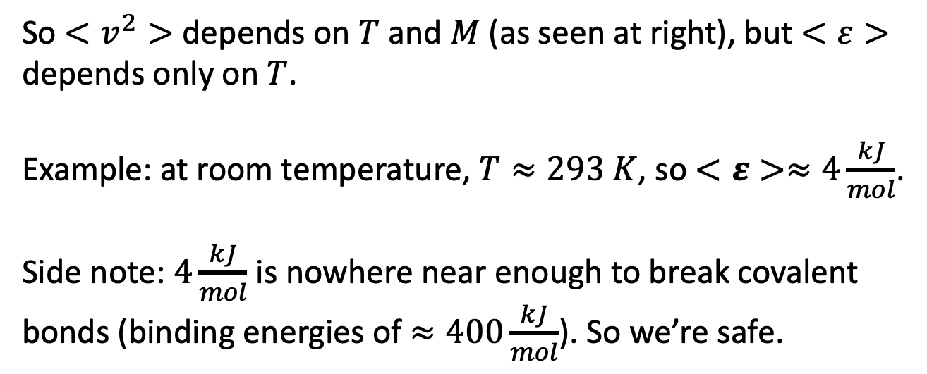

Recap: average kinetic energy depends only on the temperature (not the mass)
We saw that $<v^{2}> =\frac{3RT}{M}$, while the average kinetic energy of a mole of gas molecules is
$$<ε>{=N}_{A}<\frac{1}{2}mv^{2}> =\frac{1}{2}M\frac{3RT}{M}=\frac{3}{2}RT$$
So $<v^{2}>$ depends on $T$ and $M$ (as seen at right), but $<ε>$ depends only on $T$.
Example: at room temperature, $T≈293 K$, so $<ε>≈4\frac{kJ}{mol}$.
Side note: $4\frac{kJ}{mol}$ is nowhere near enough to break covalent bonds (binding energies of $≈400\frac{kJ}{mol}$). So we’re safe.

Slide 3
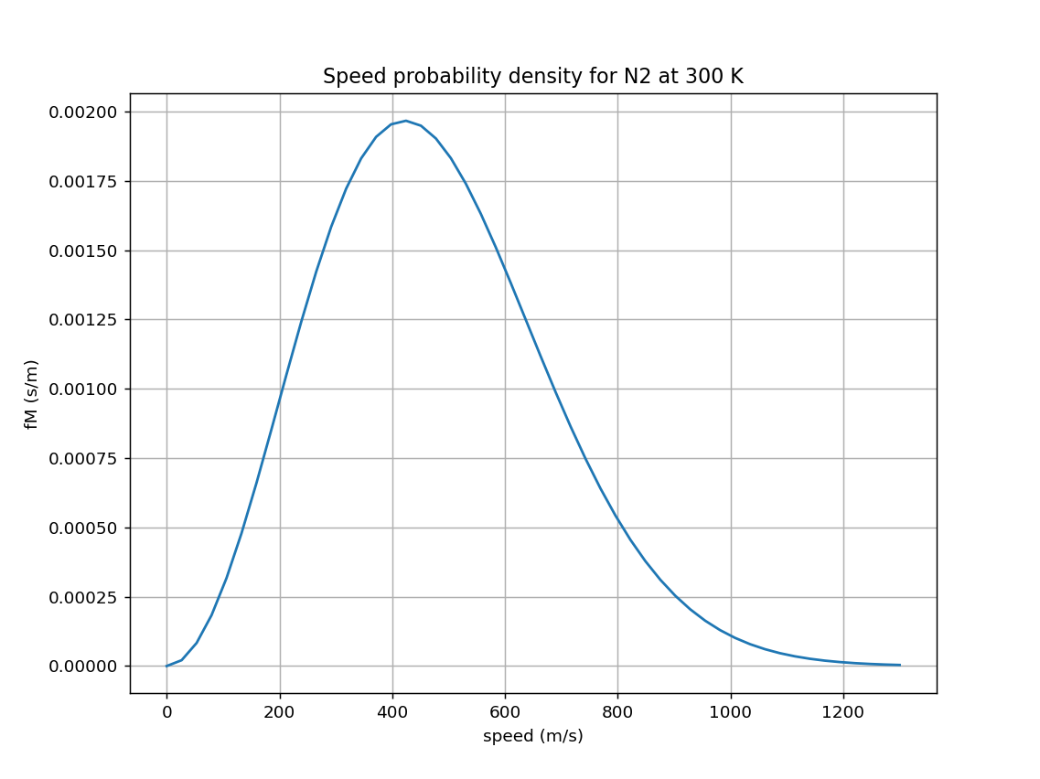
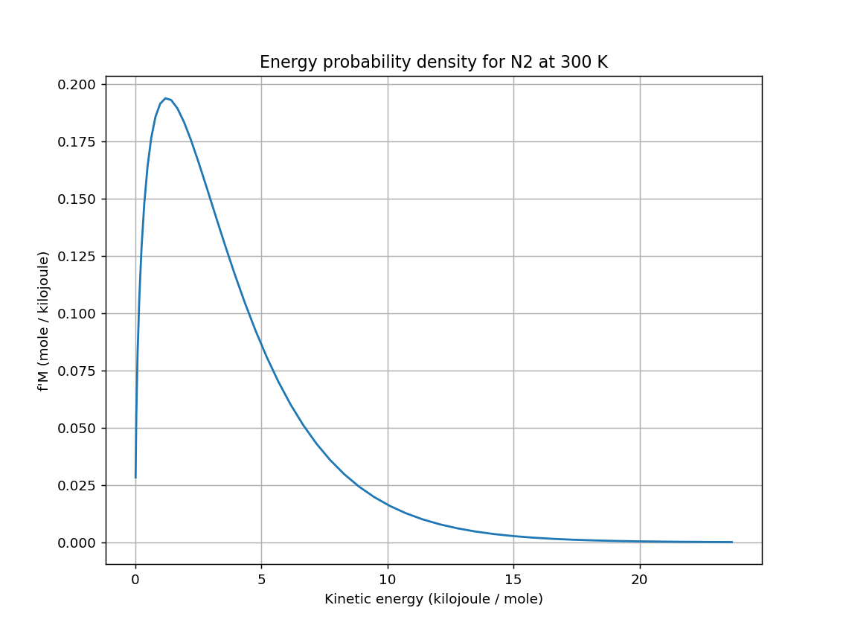
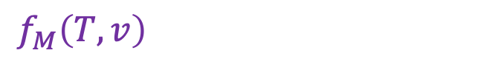
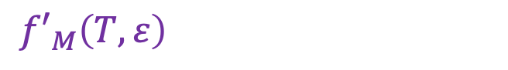
Transforming from one probability density to another
OK … what if we wanted to think about all this in terms of kinetic energy instead of speed?
Speed probability density
Energy probability density
$f_{M}\left(T,v\right)$
${f′}_{M}\left(T,ε\right)$
$$∆v$$
$$∆ε$$
${f′}_{M}\left(T,ε\right)∆ε=f_{M}\left(T,v\right)∆v$ => ${f′}_{M}\left(T,ε\right)=f_{M}\left(T,v\right)$ $\frac{∆v}{∆ε}$

Slide 4
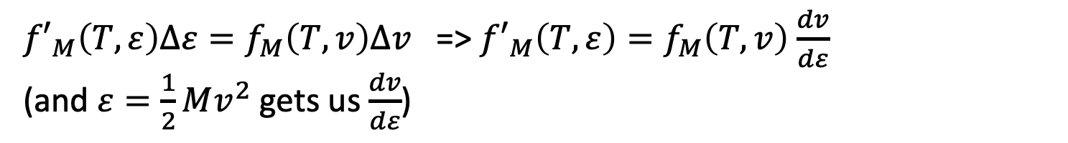
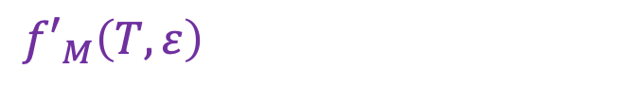
Transforming from one probability density to another
OK … what if we wanted to think about all this in terms of kinetic energy instead of speed?
Speed probability density
Energy probability density
$f_{M}\left(T,v\right)$
${f′}_{M}\left(T,ε\right)$
$$∆v$$
$$∆ε$$
${f′}_{M}\left(T,ε\right)∆ε=f_{M}\left(T,v\right)∆v$ => ${f′}_{M}\left(T,ε\right)=f_{M}\left(T,v\right)$ $\frac{dv}{dε}$
(and $ε=\frac{1}{2}Mv^{2}$ gets us $\frac{dv}{dε}$)

Slide 5
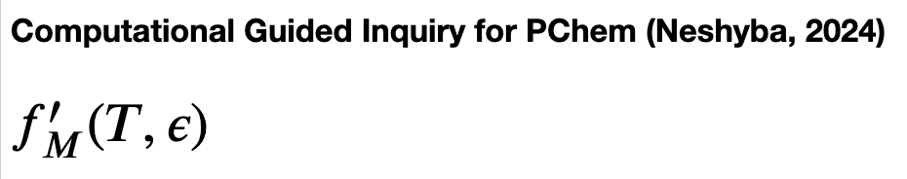
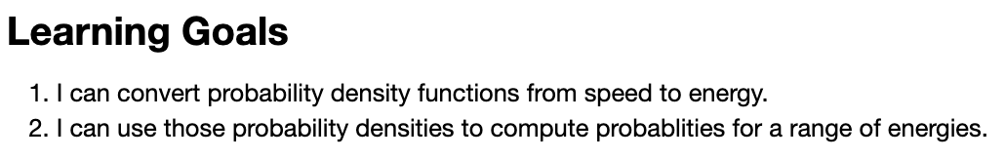
Let’s get started

